Slide 2


Slide 3
Modelling of Power Consumption
Model Validation
Model Combination

Slide 4
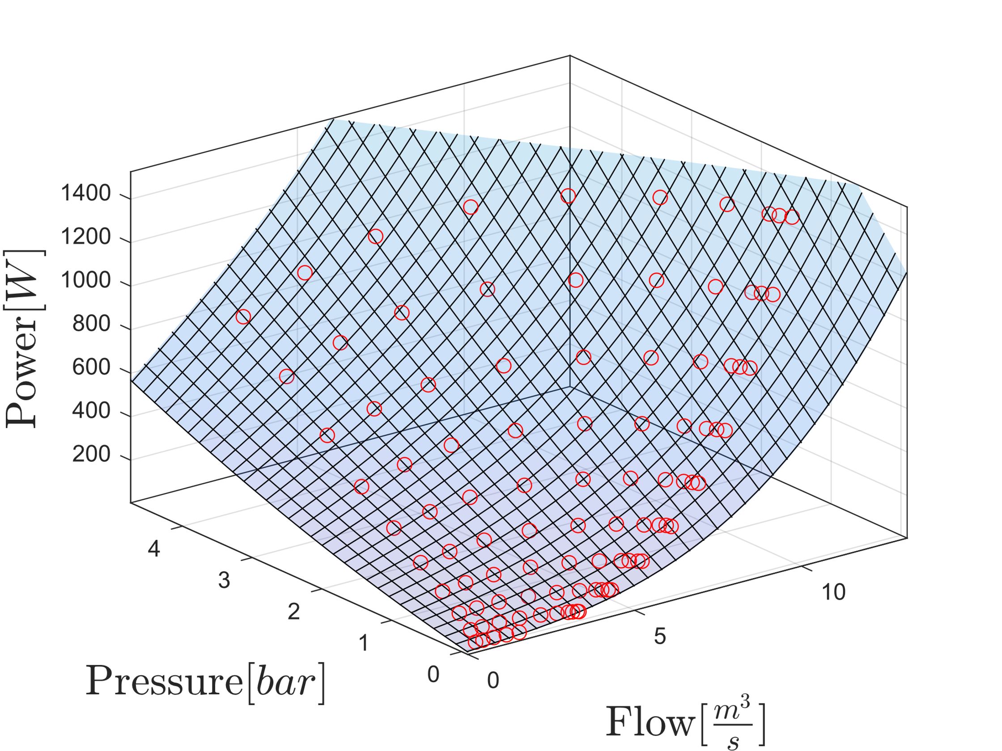
Power consumption
Model for single pump

Slide 5
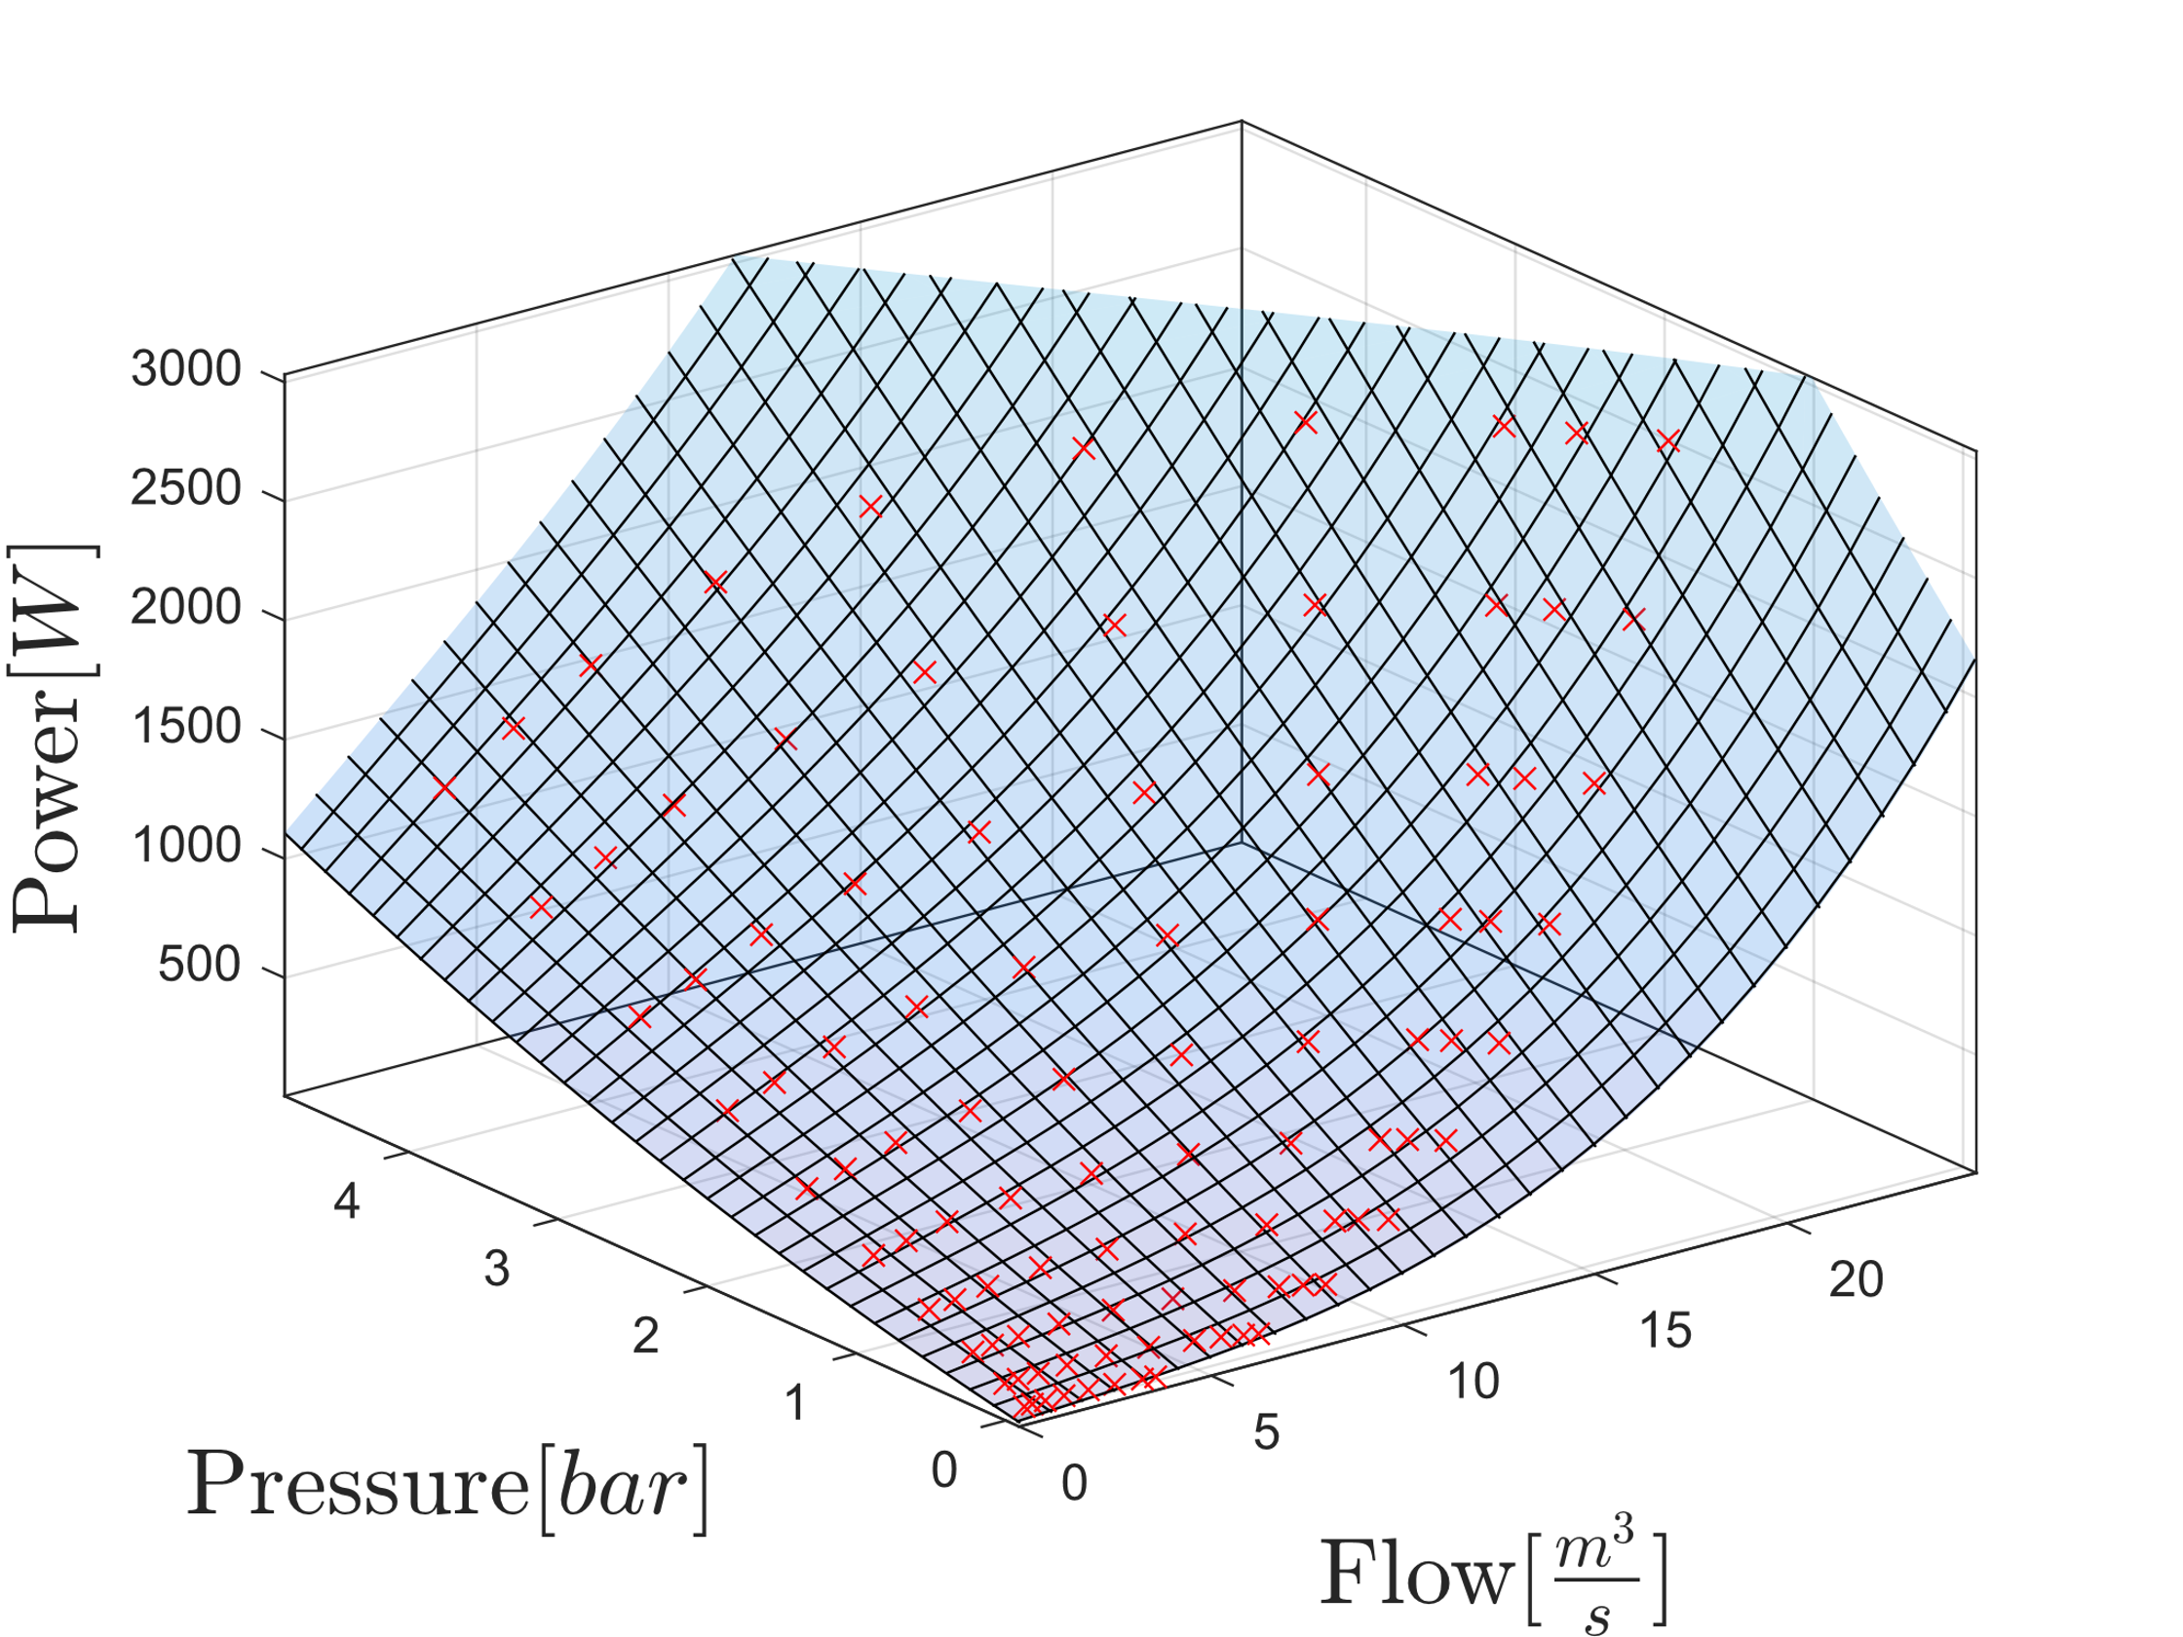
Power consumption
Model for two pumps

Slide 6
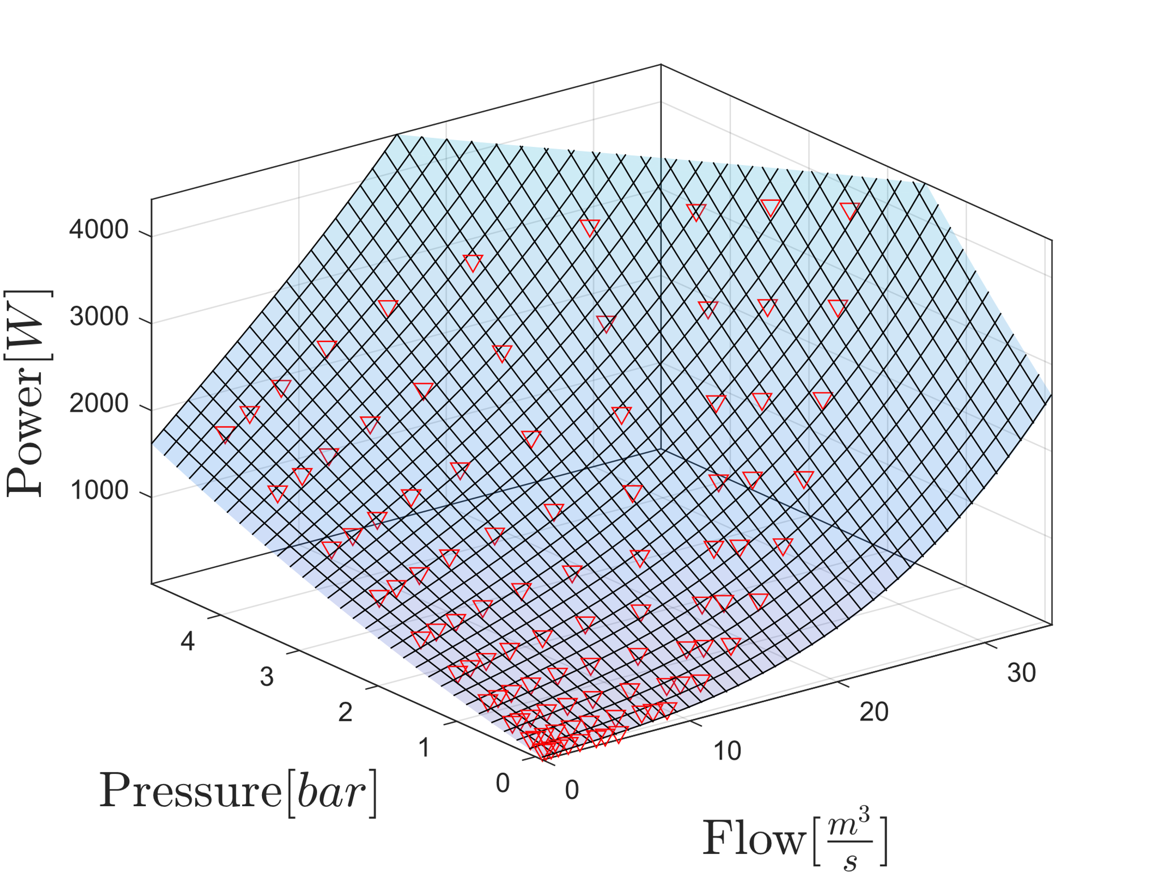
Power consumption
Model for three pumps

Slide 7
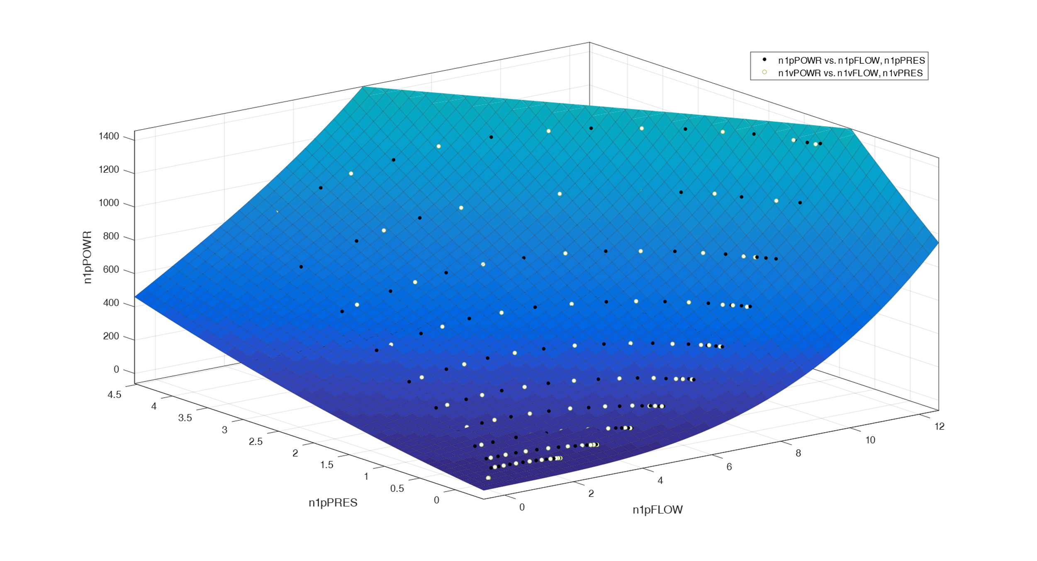
Model Validation
Validation for one pump

Slide 8
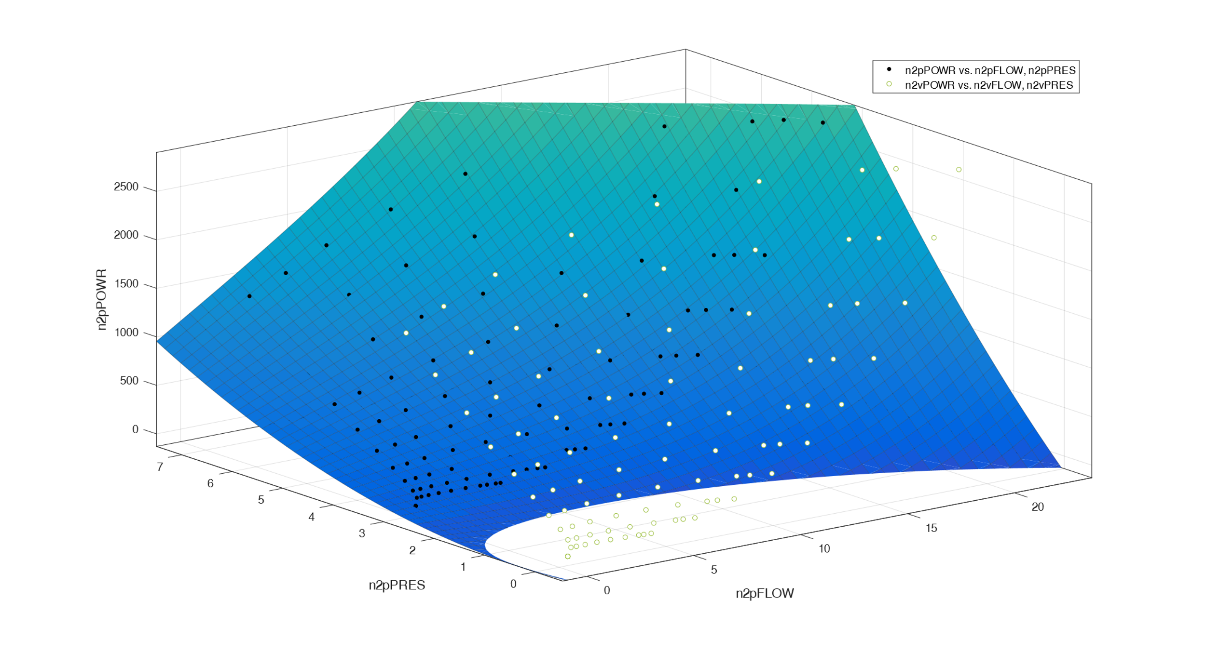
Model Validation
Validation for two pumps
Validation data doesn’t fit

Slide 9
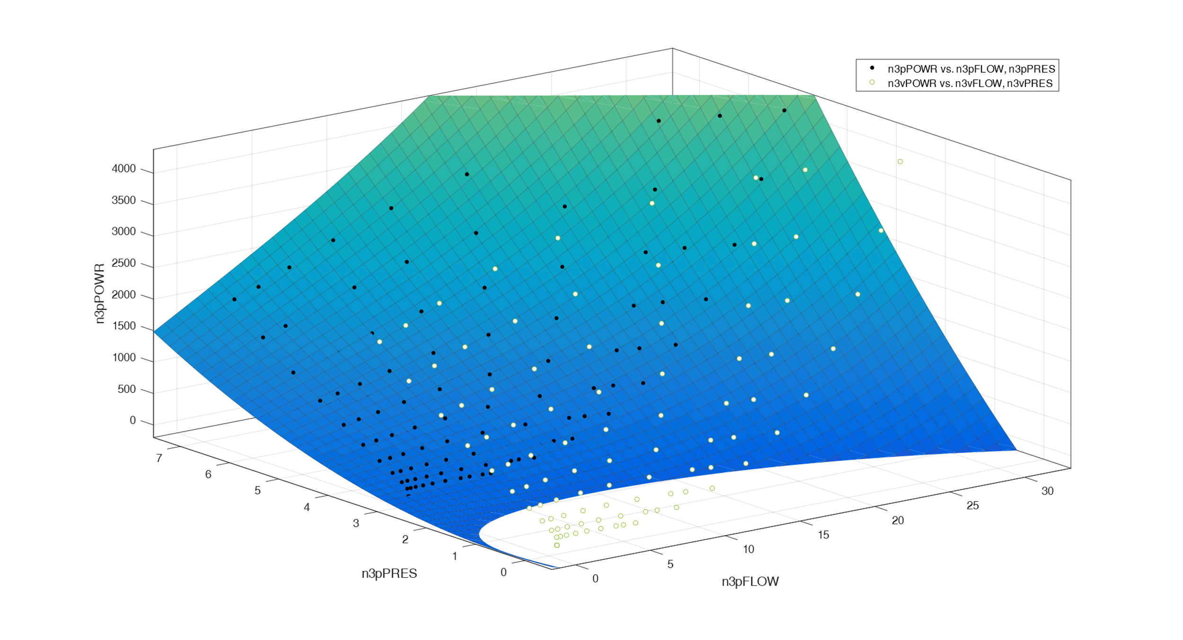
Model Validation
Validation for three pumps
Validation data doesn’t fit

Slide 10
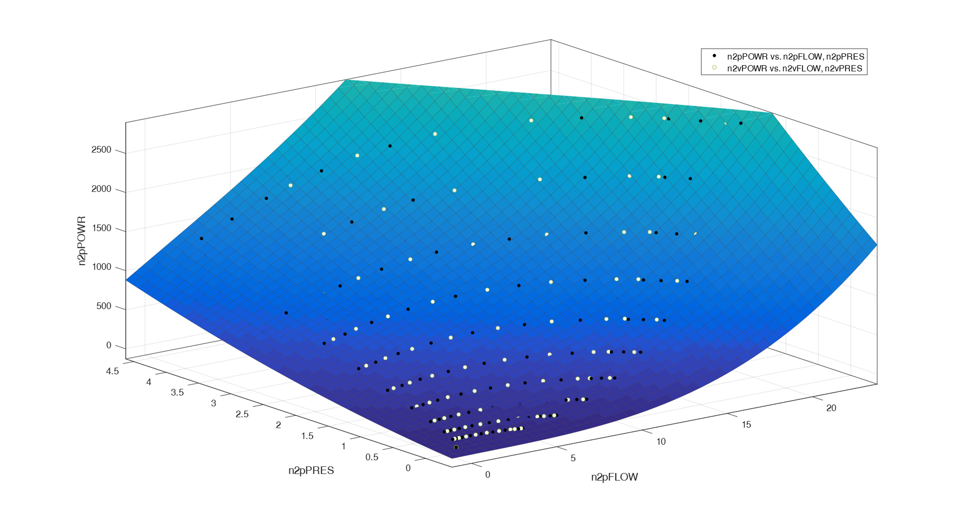
Model Validation
Validation for two pumps
Retaking the original tests, the data now fits the validation data

Slide 11
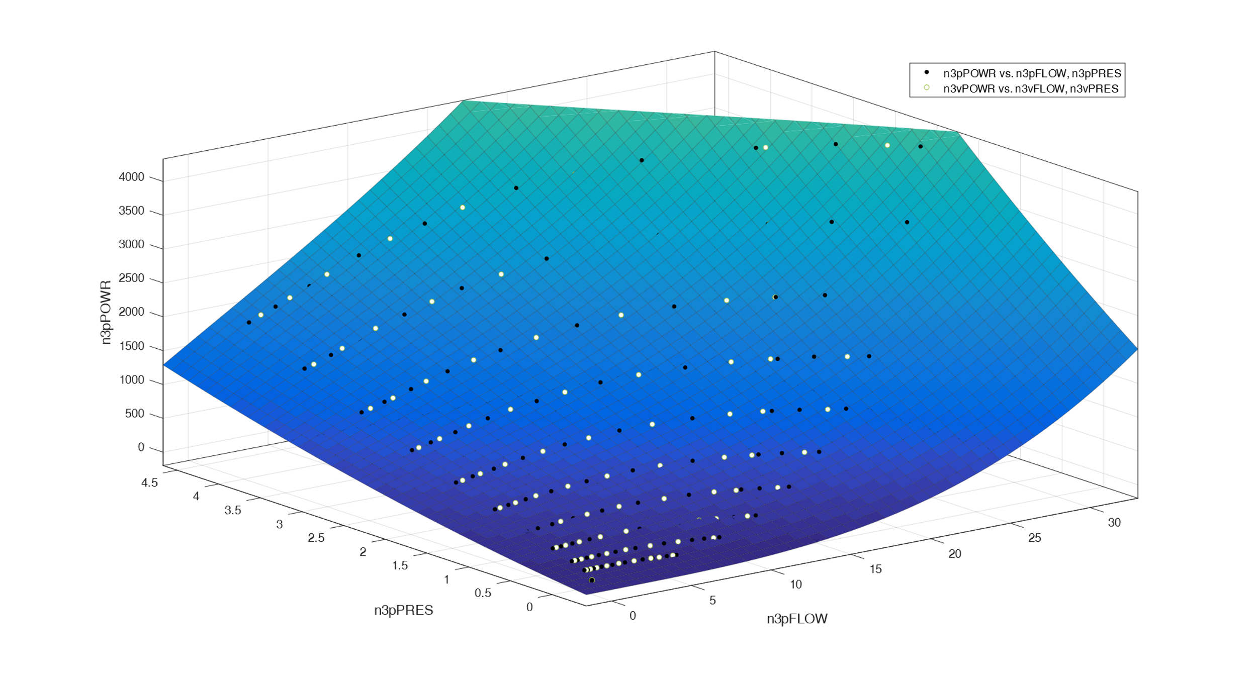
Model Validation
Validation for three pumps
Retaking the original tests, the data now fits the validation data

Slide 12
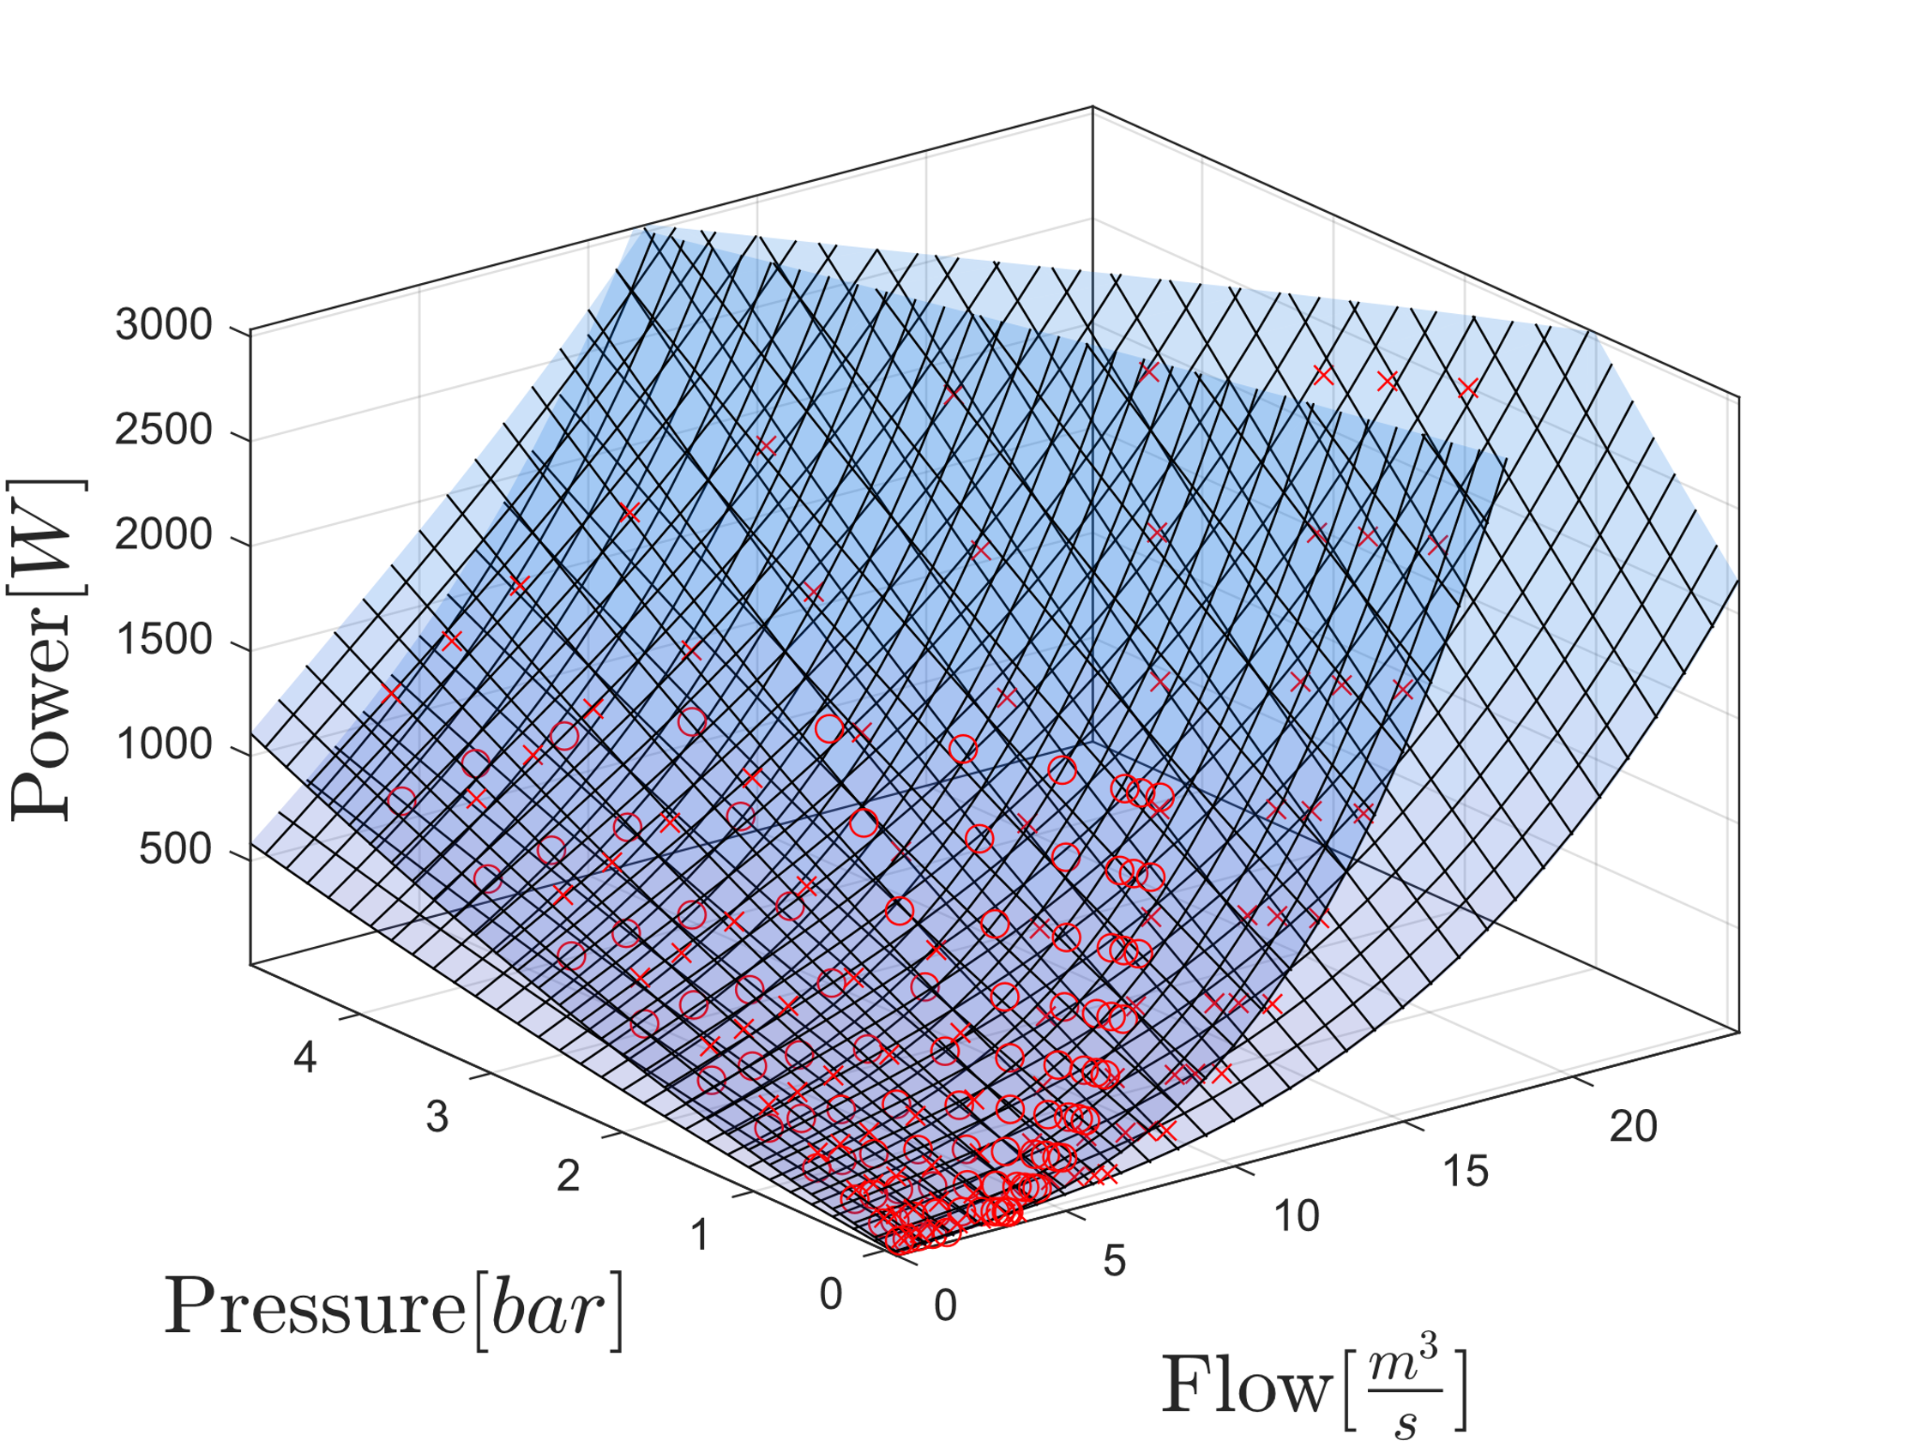
Model Combination
One and Two Pumps

Slide 13
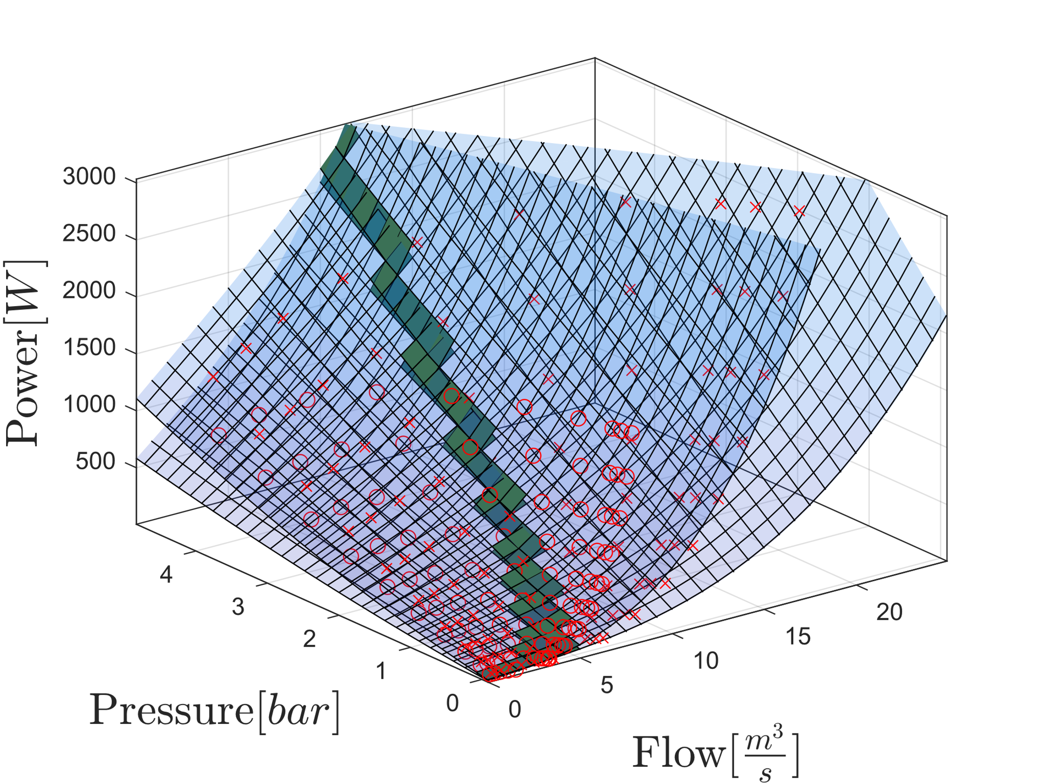
Model Combination
One and Two Pumps

Slide 14
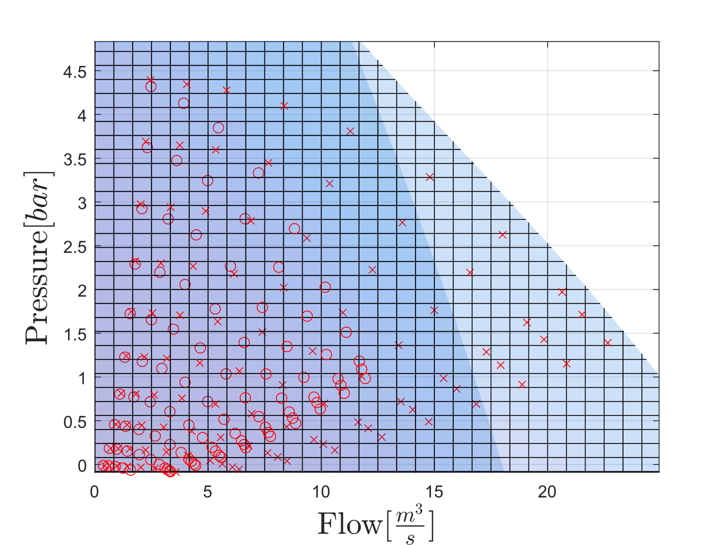
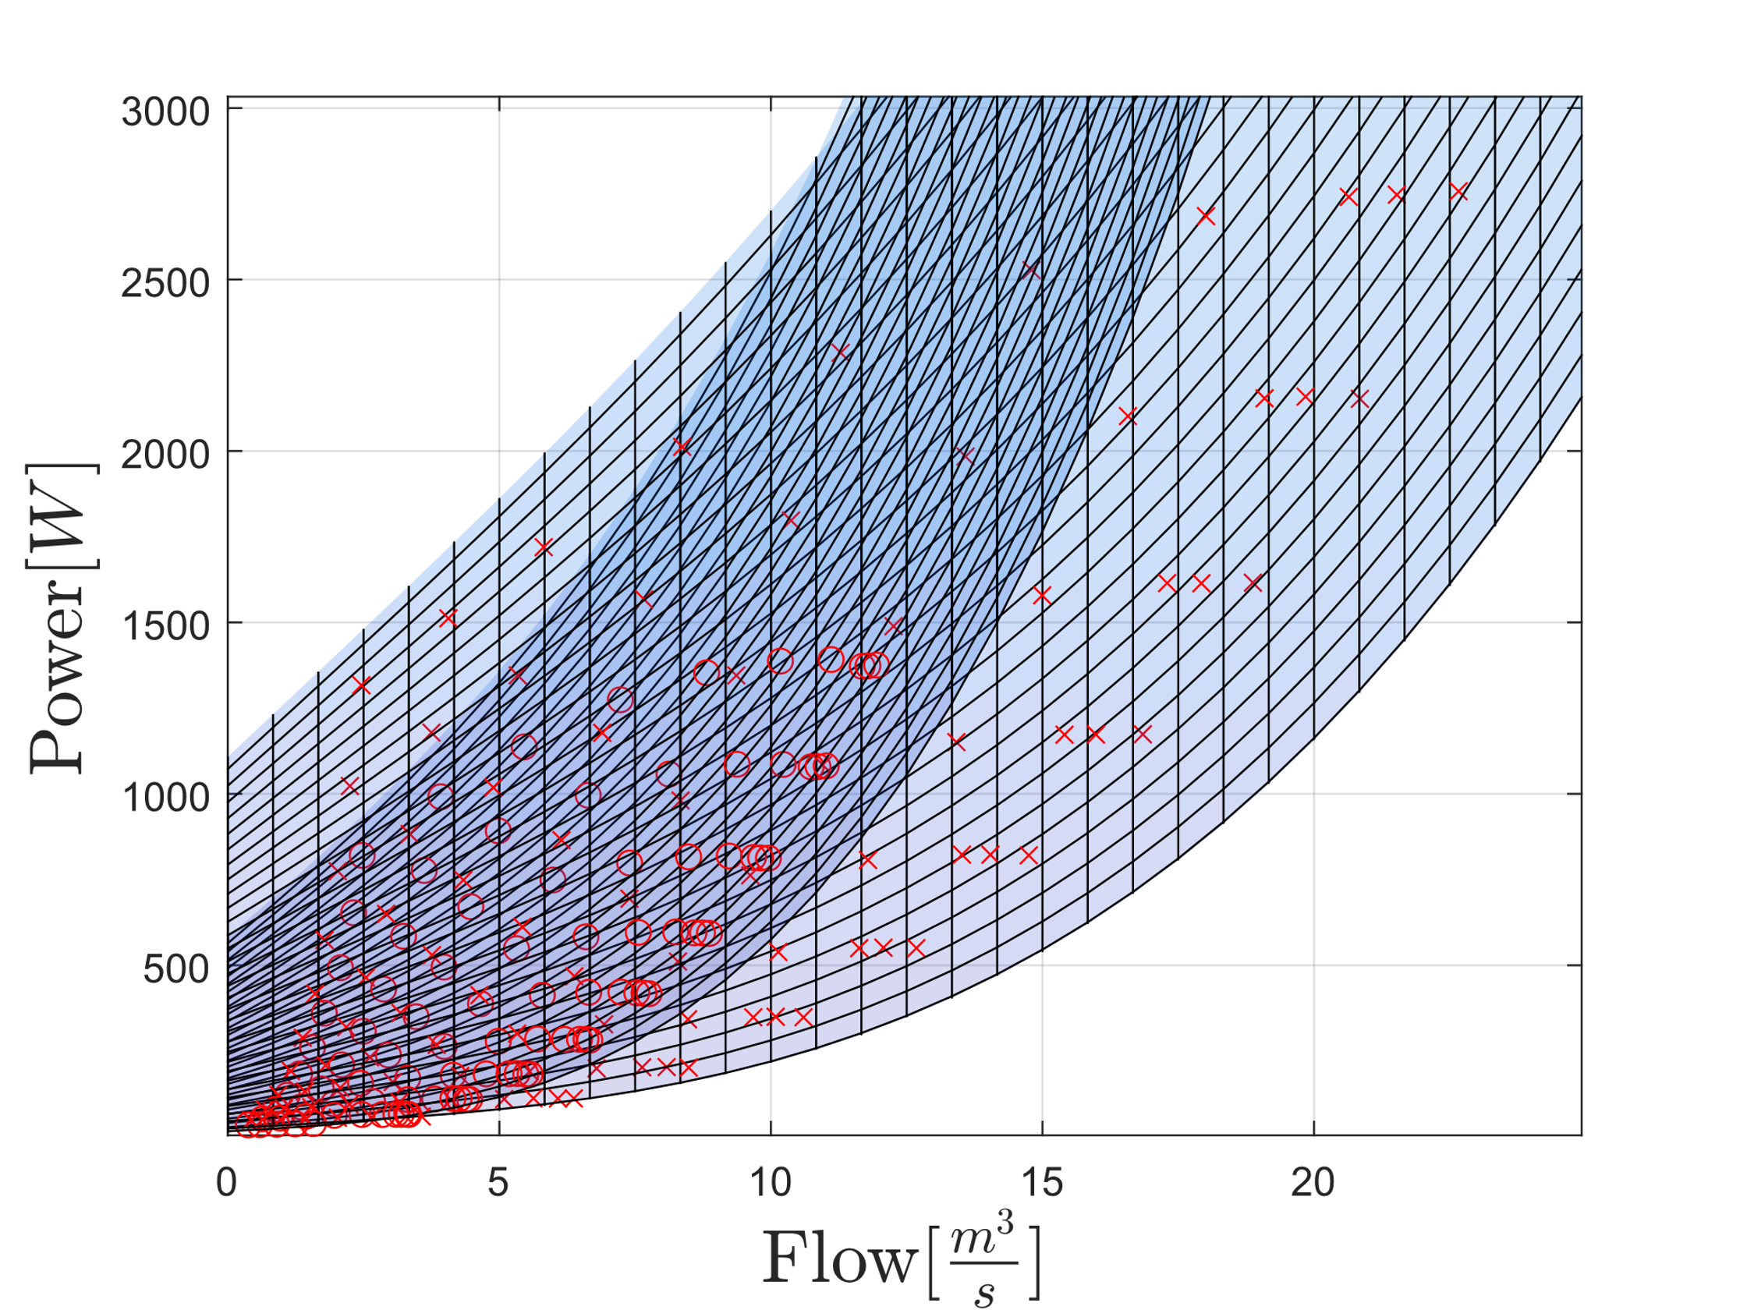
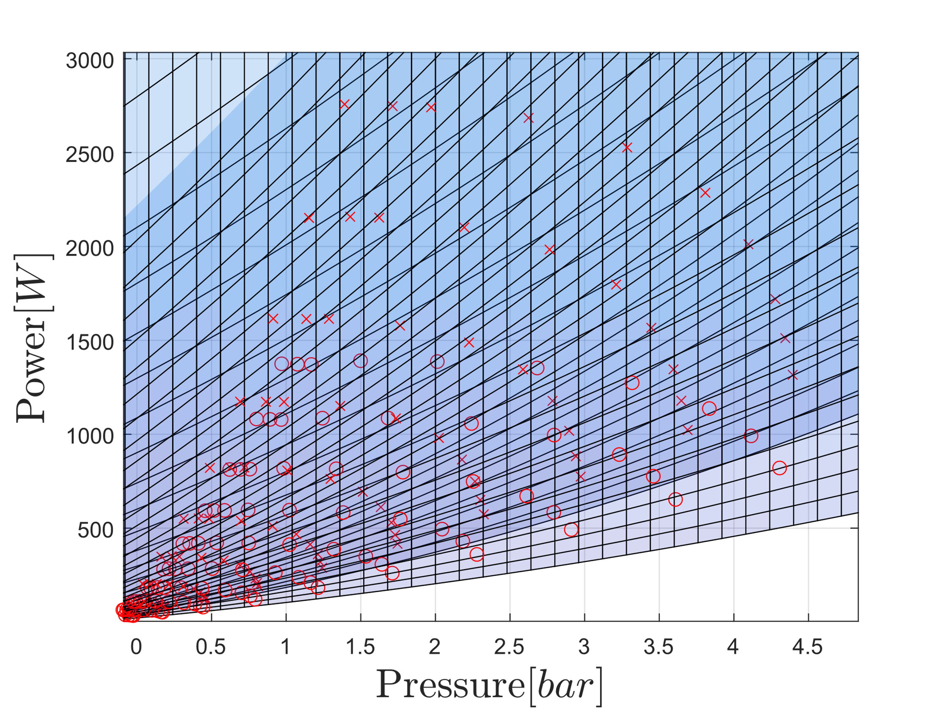

Slide 15
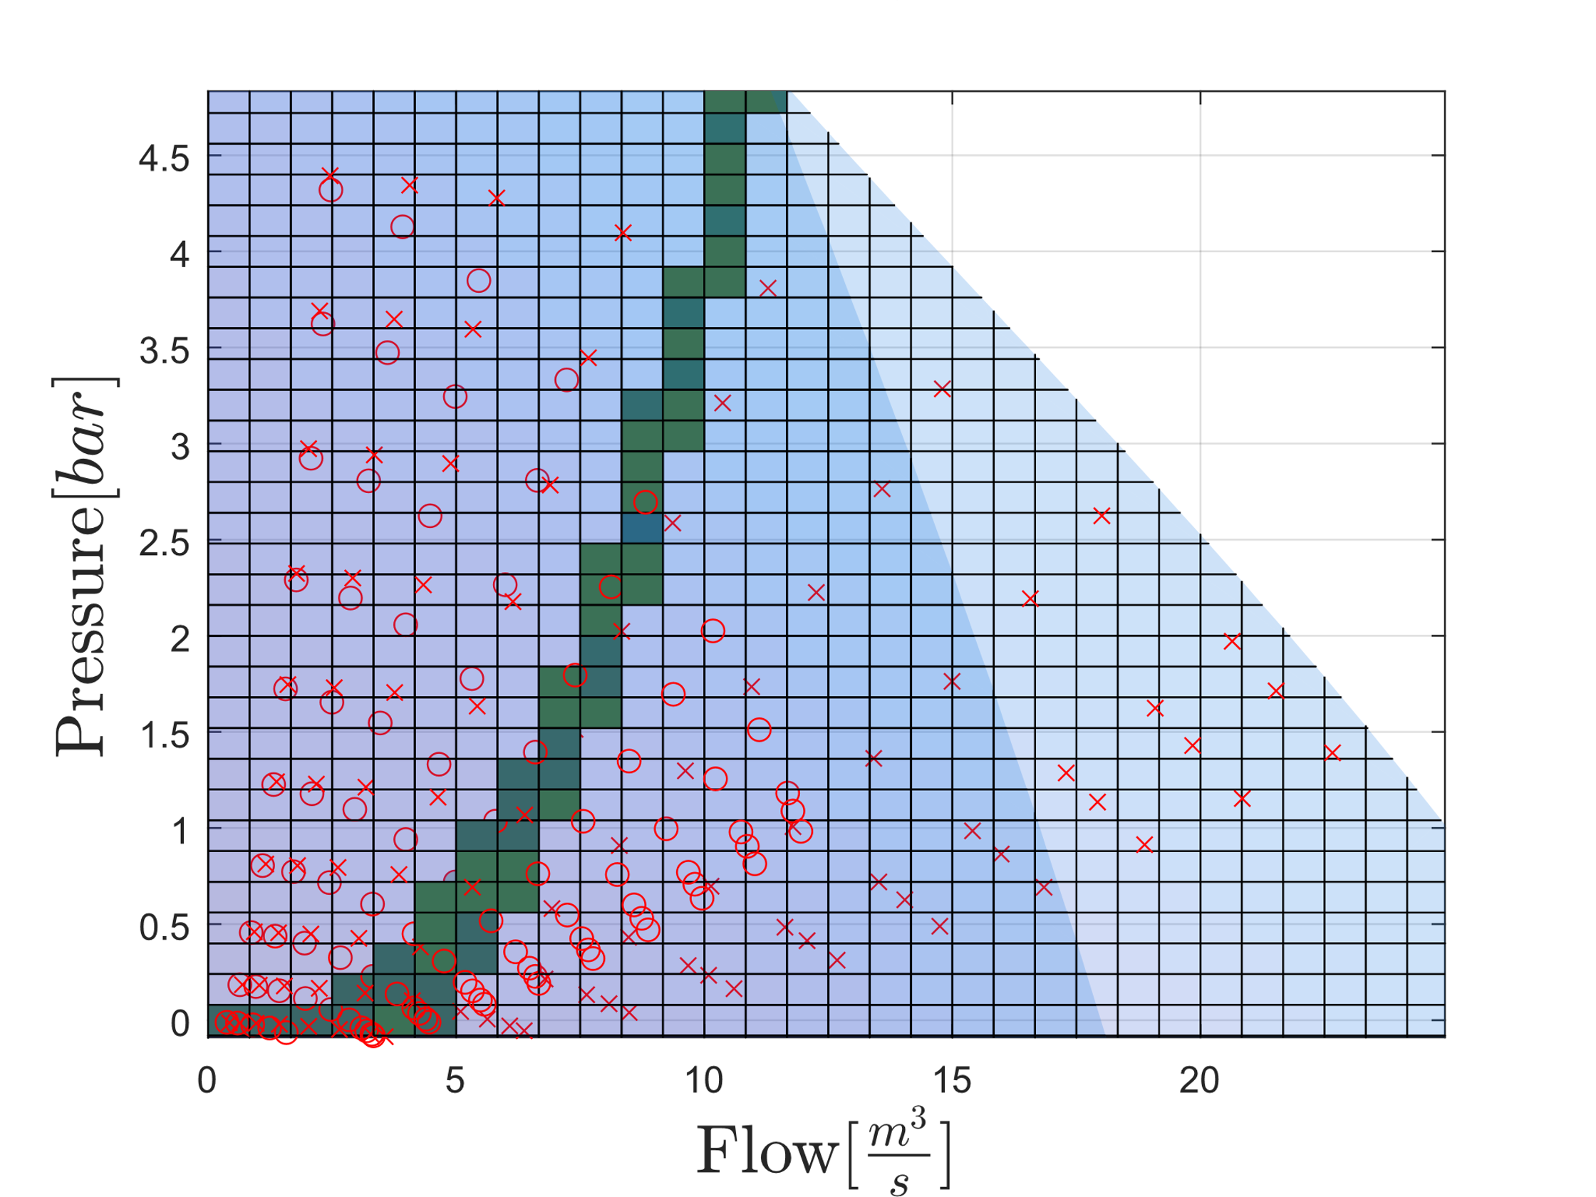
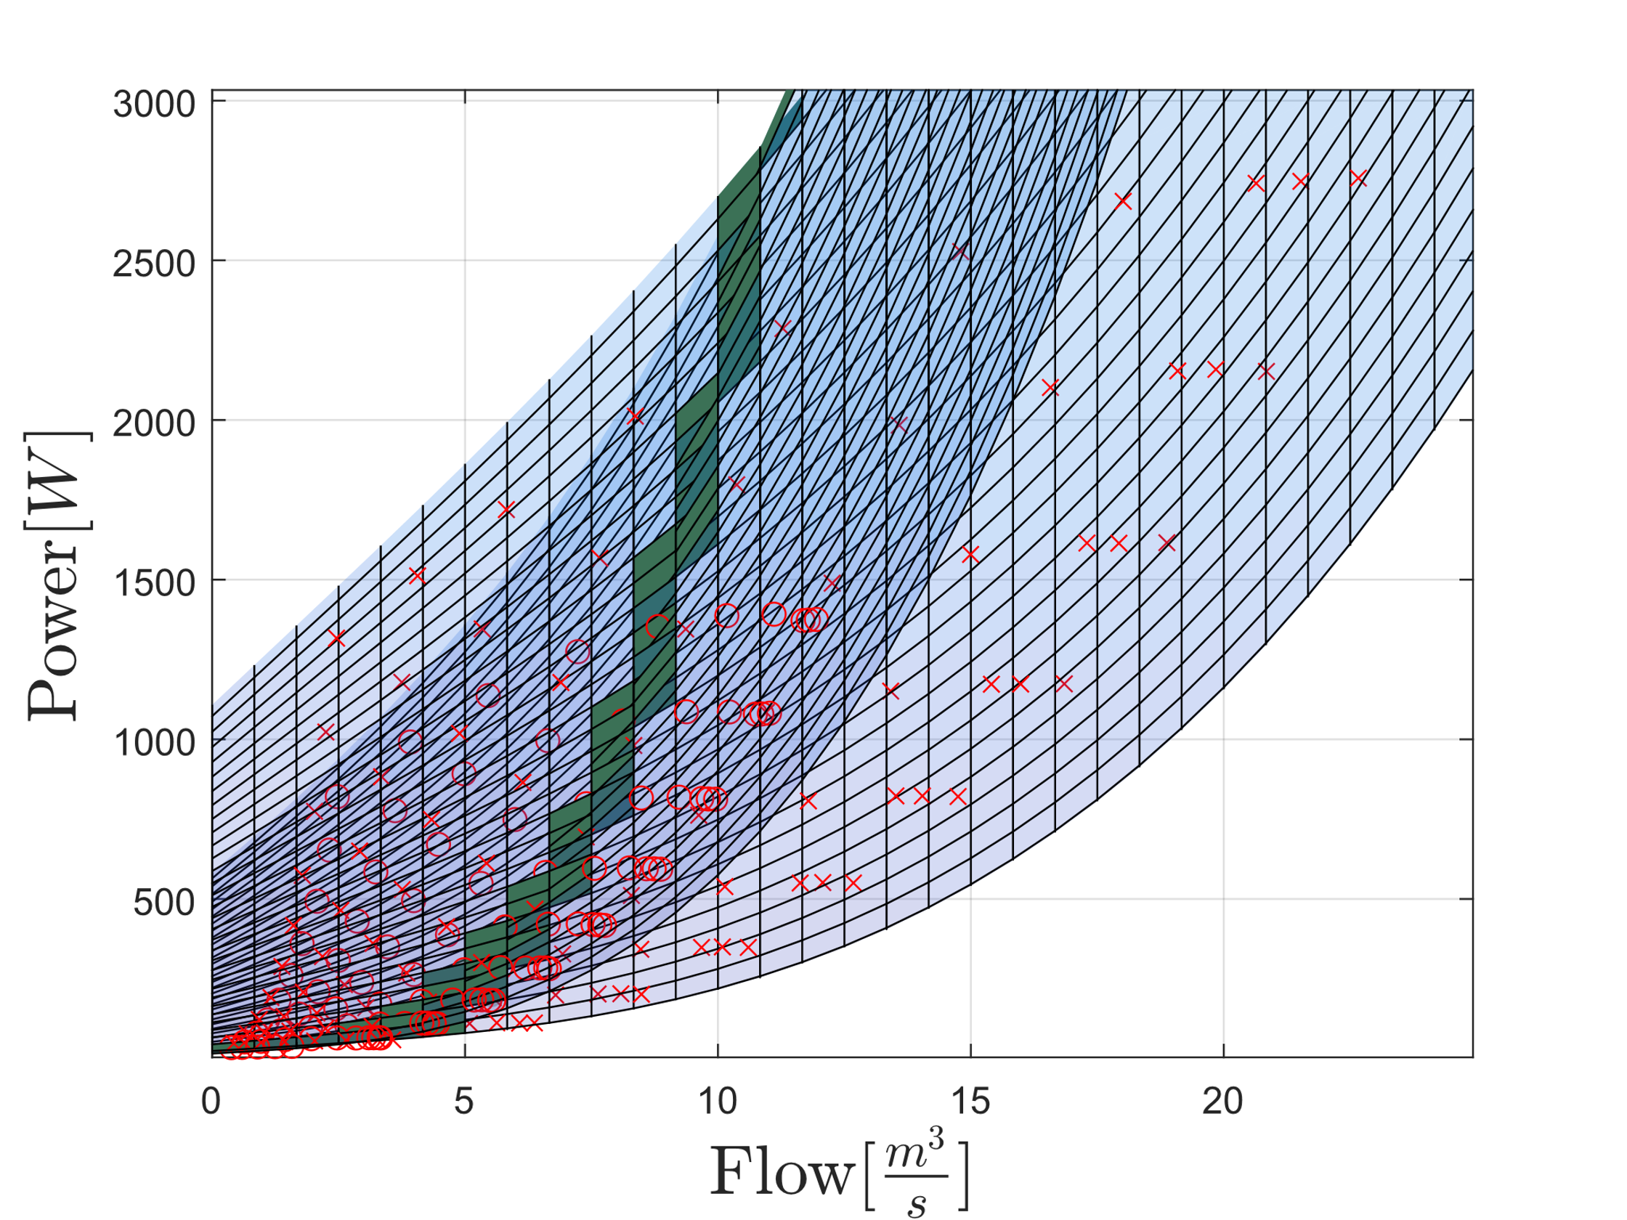
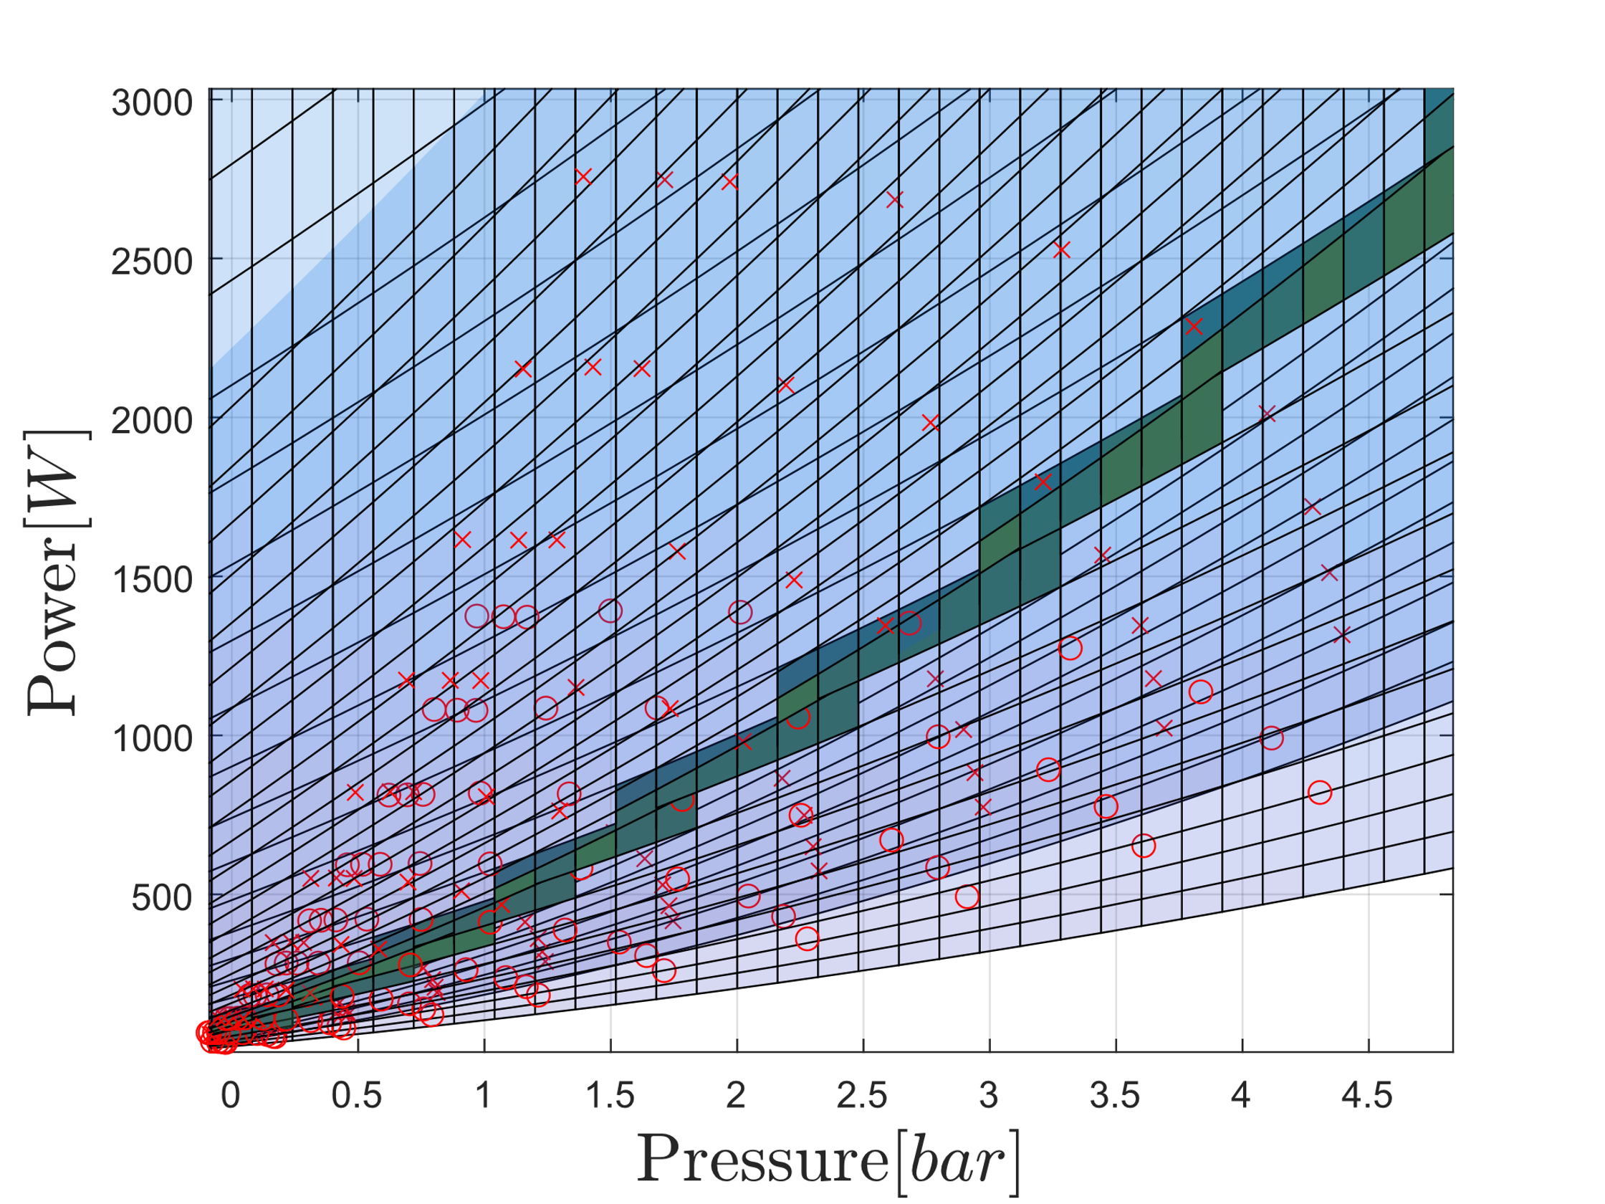

Slide 16
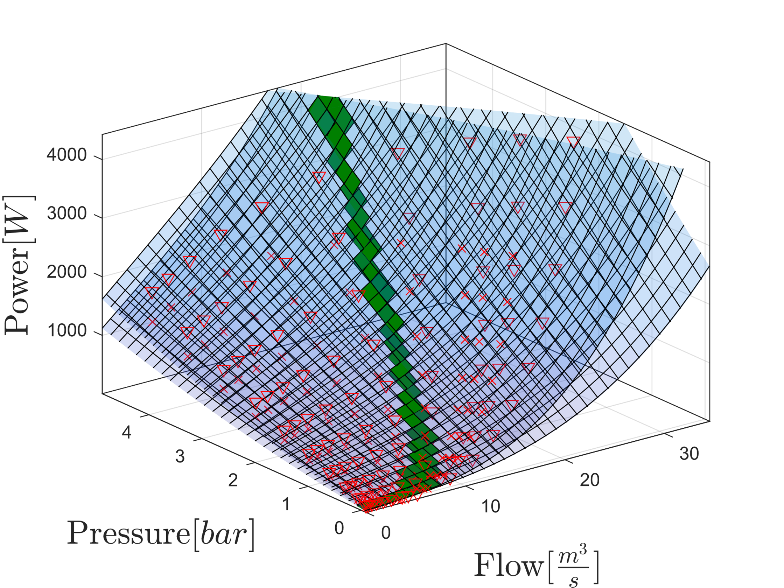
Model Combination
Two and Three Pumps

Slide 17
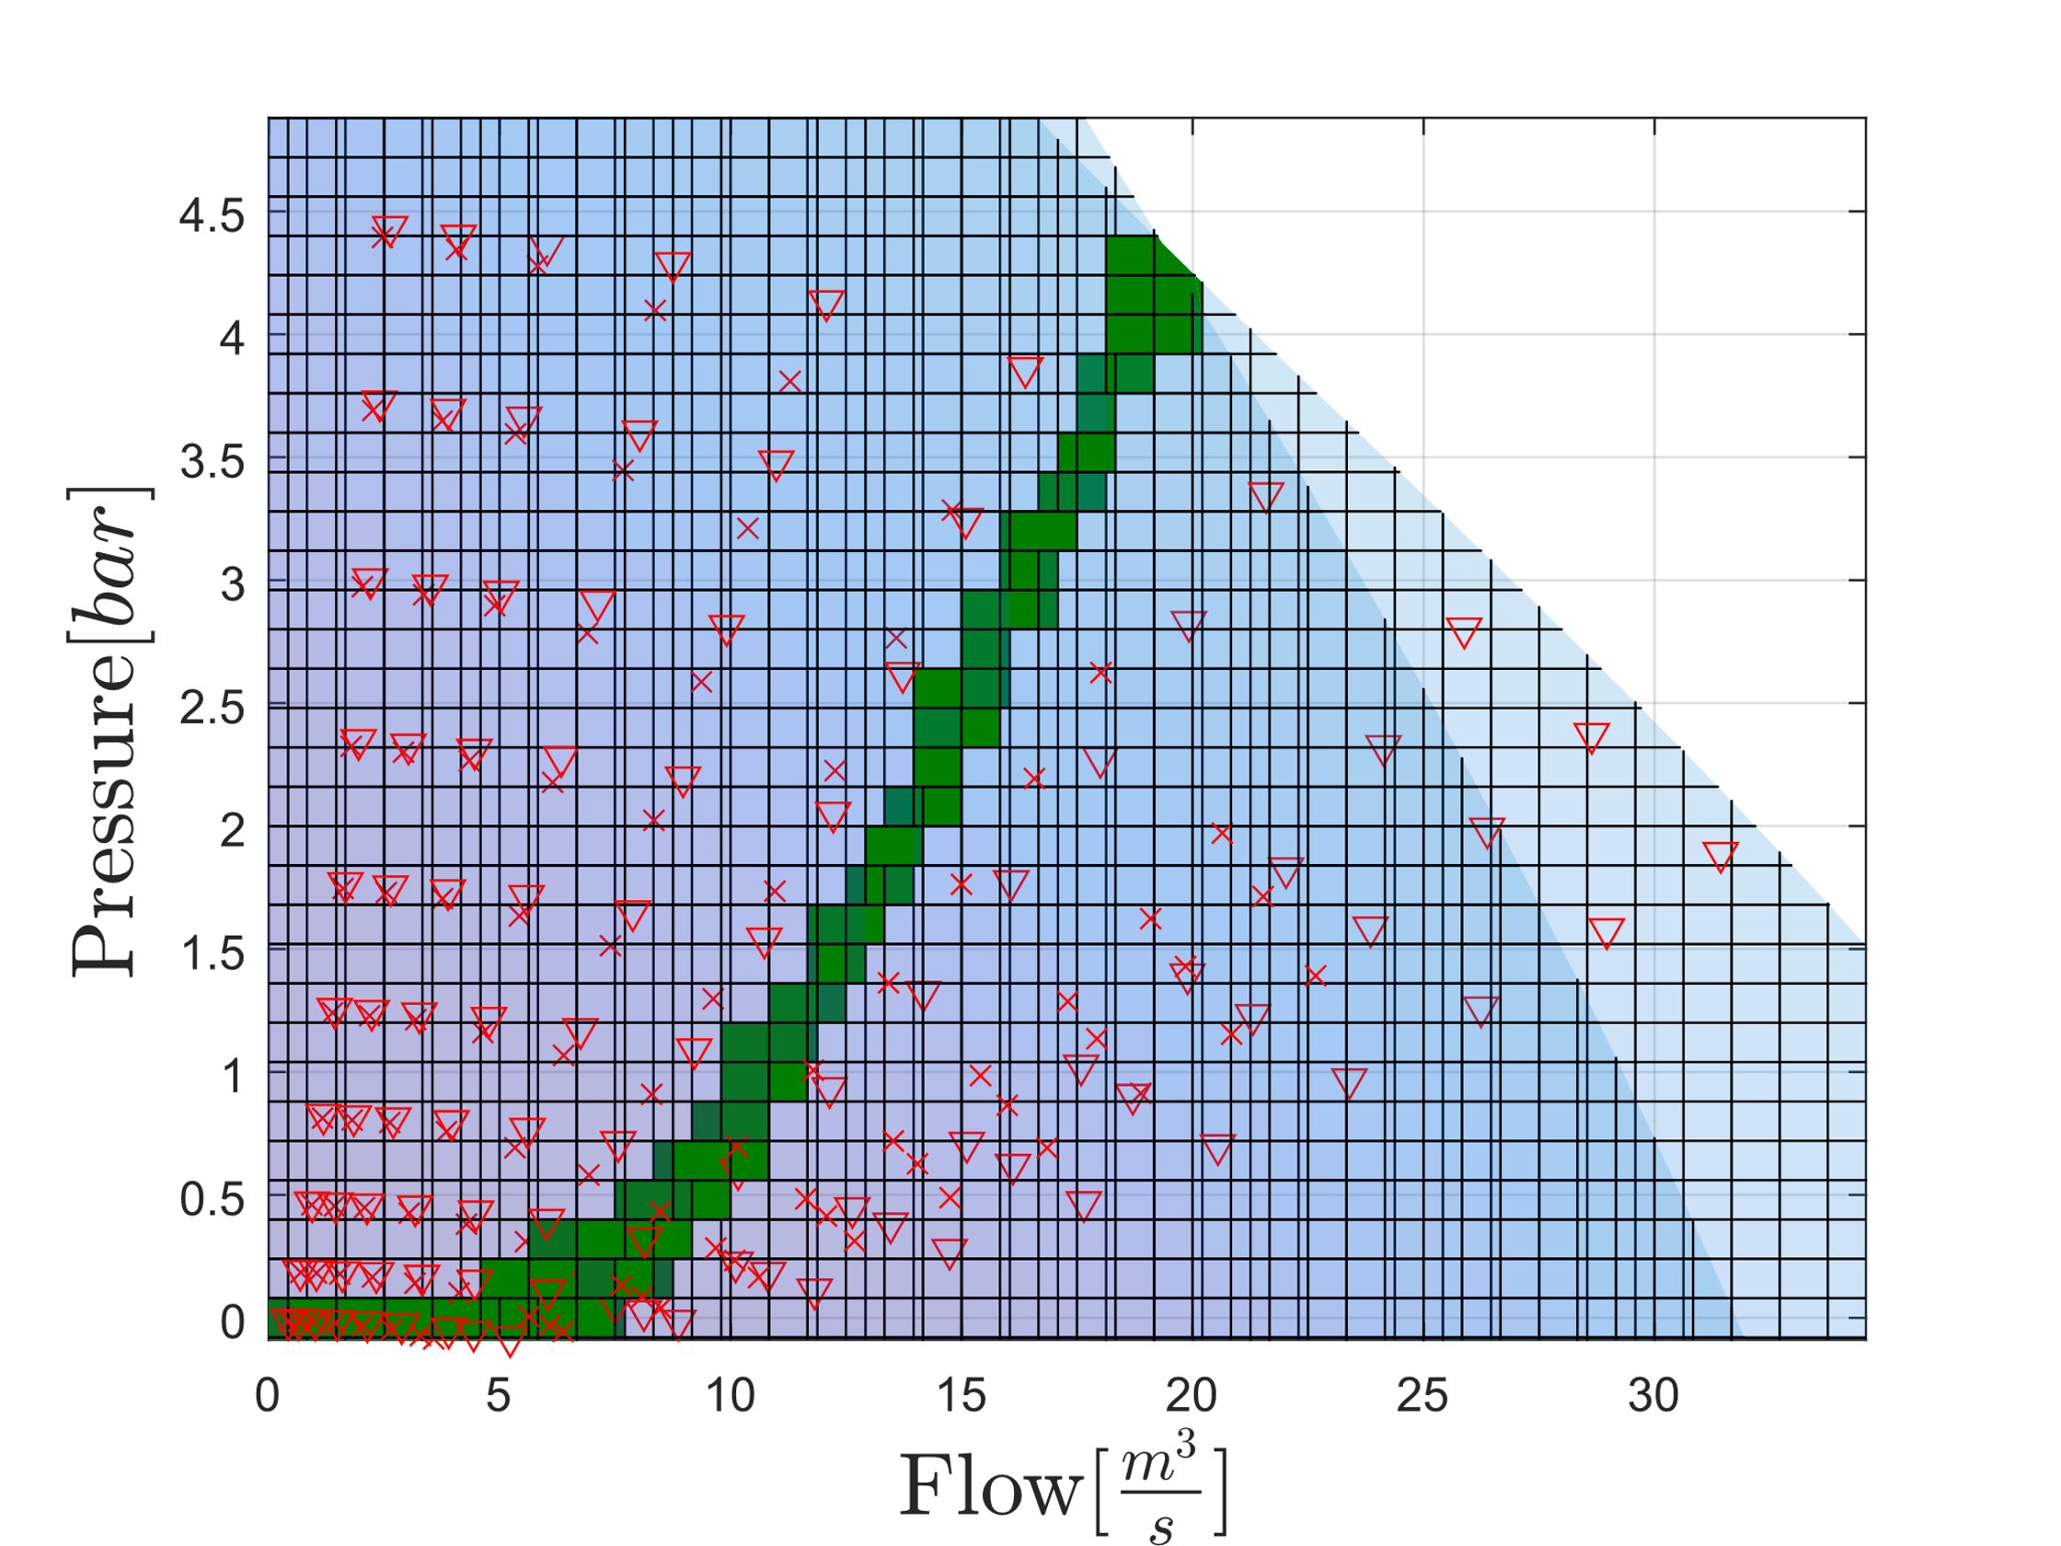
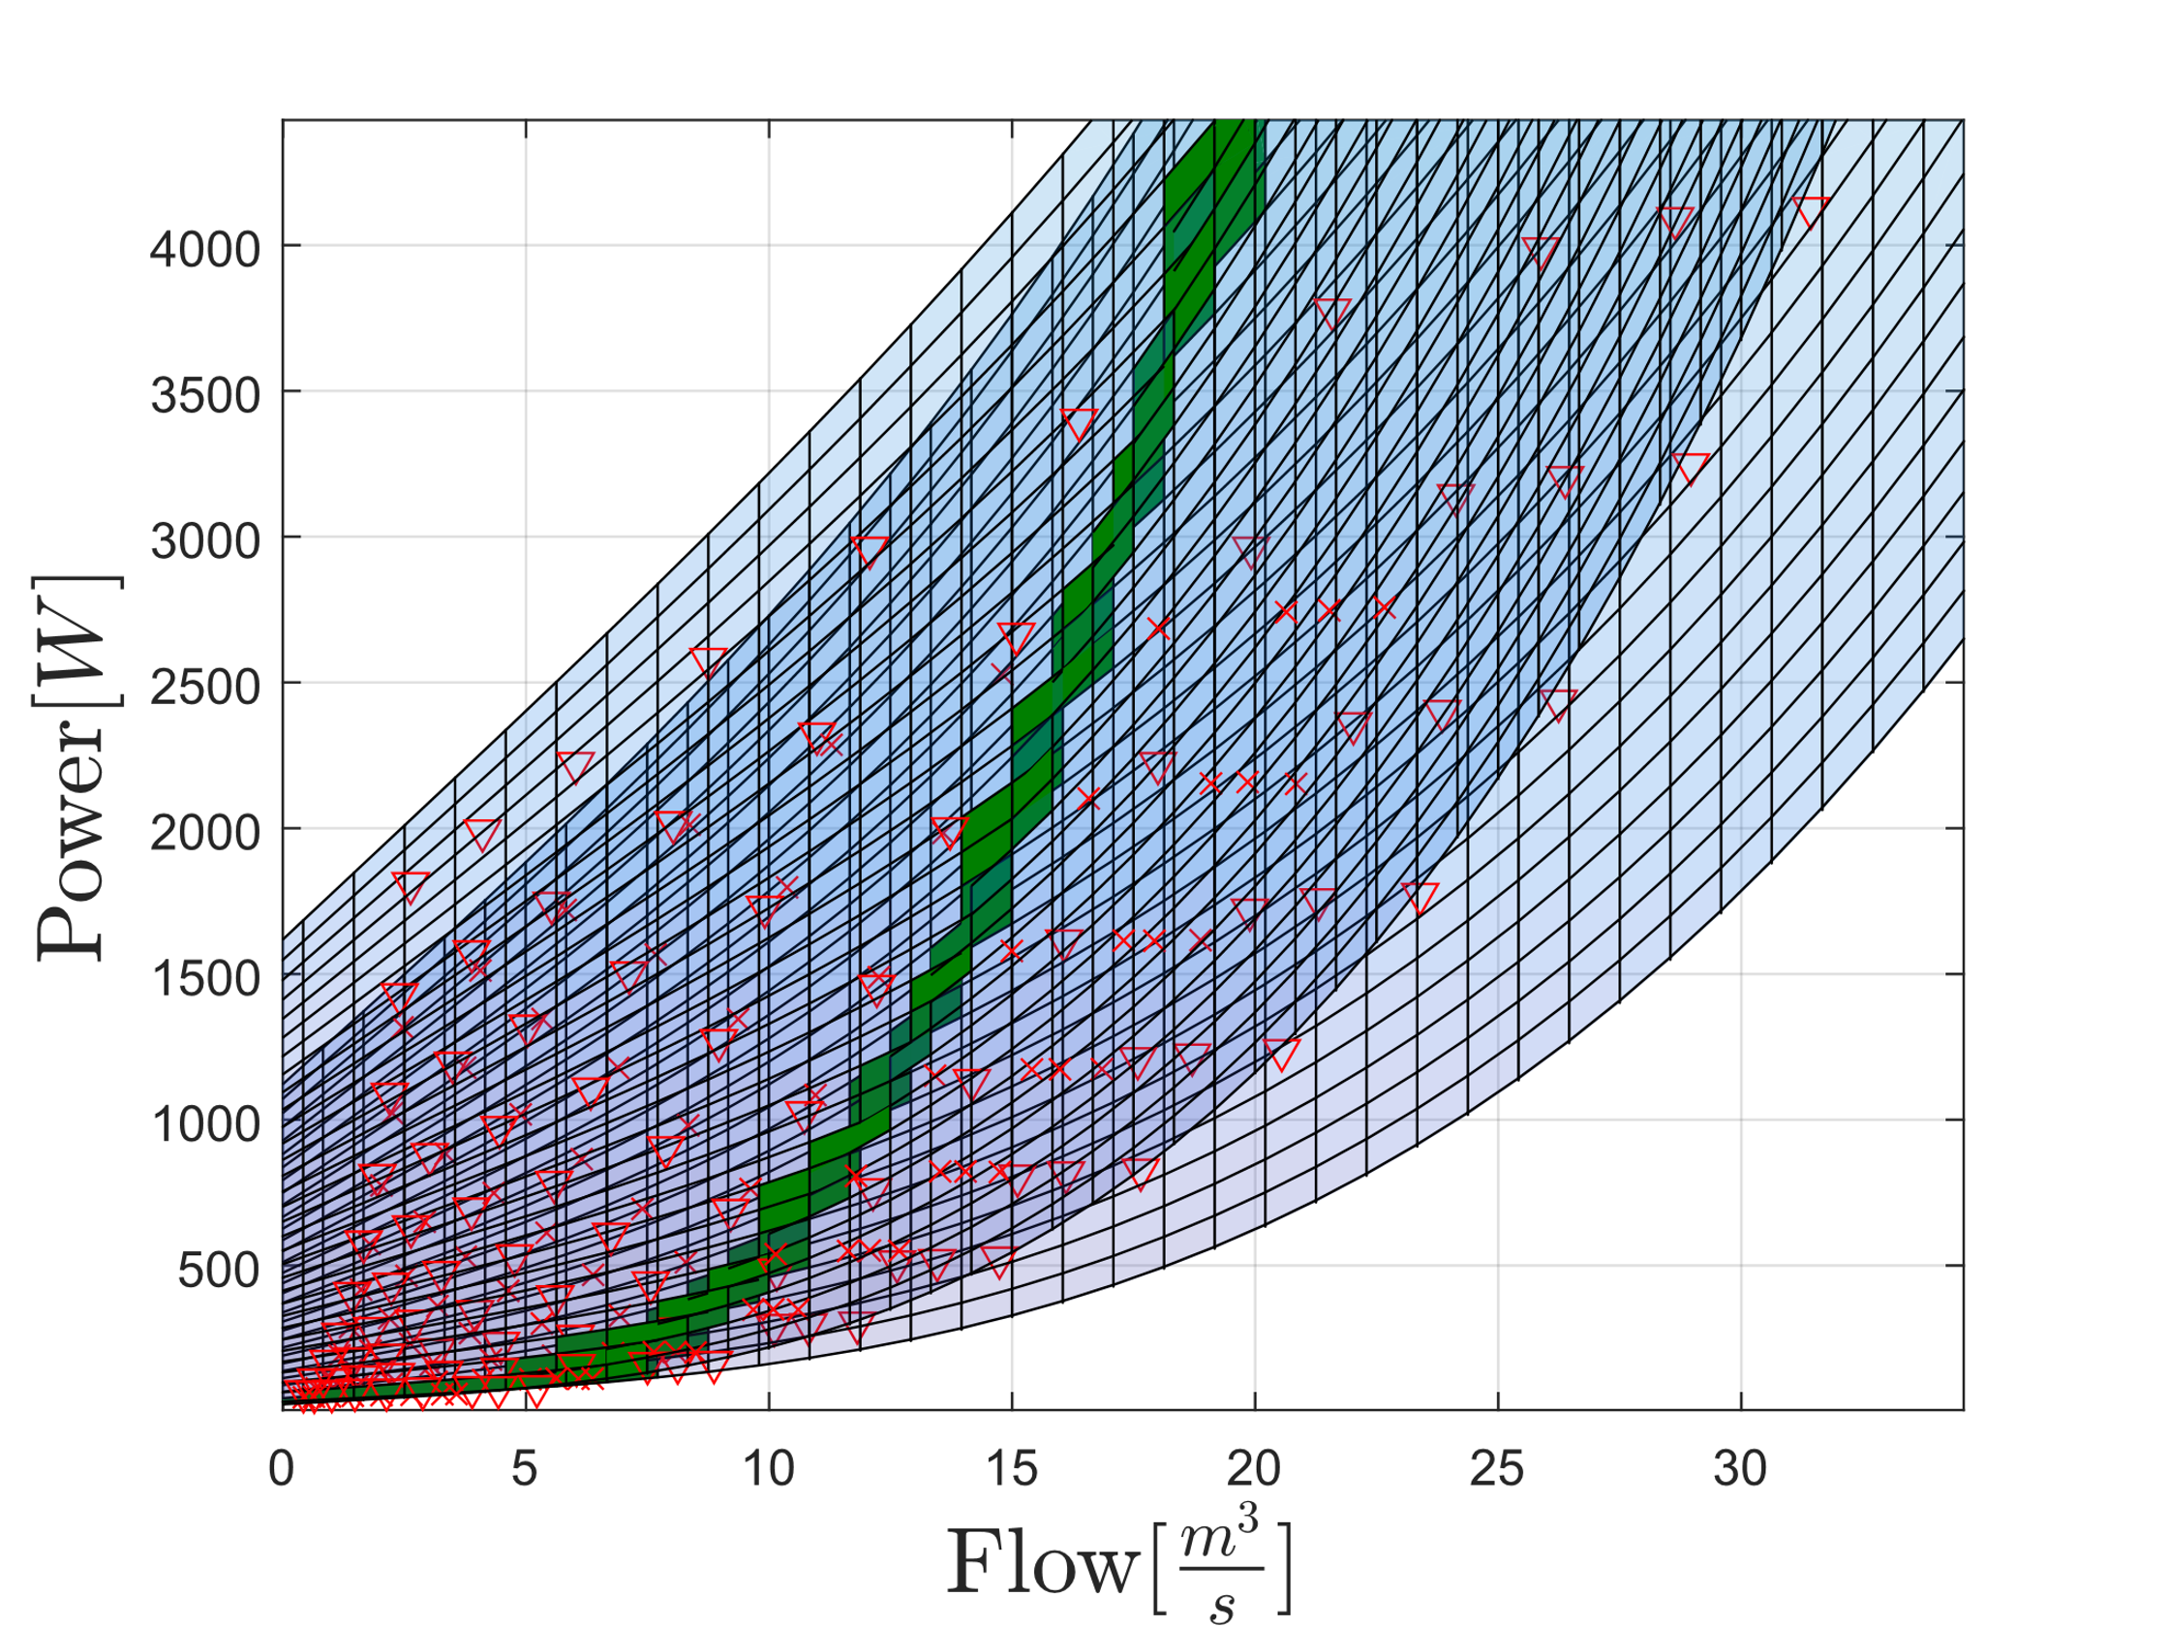
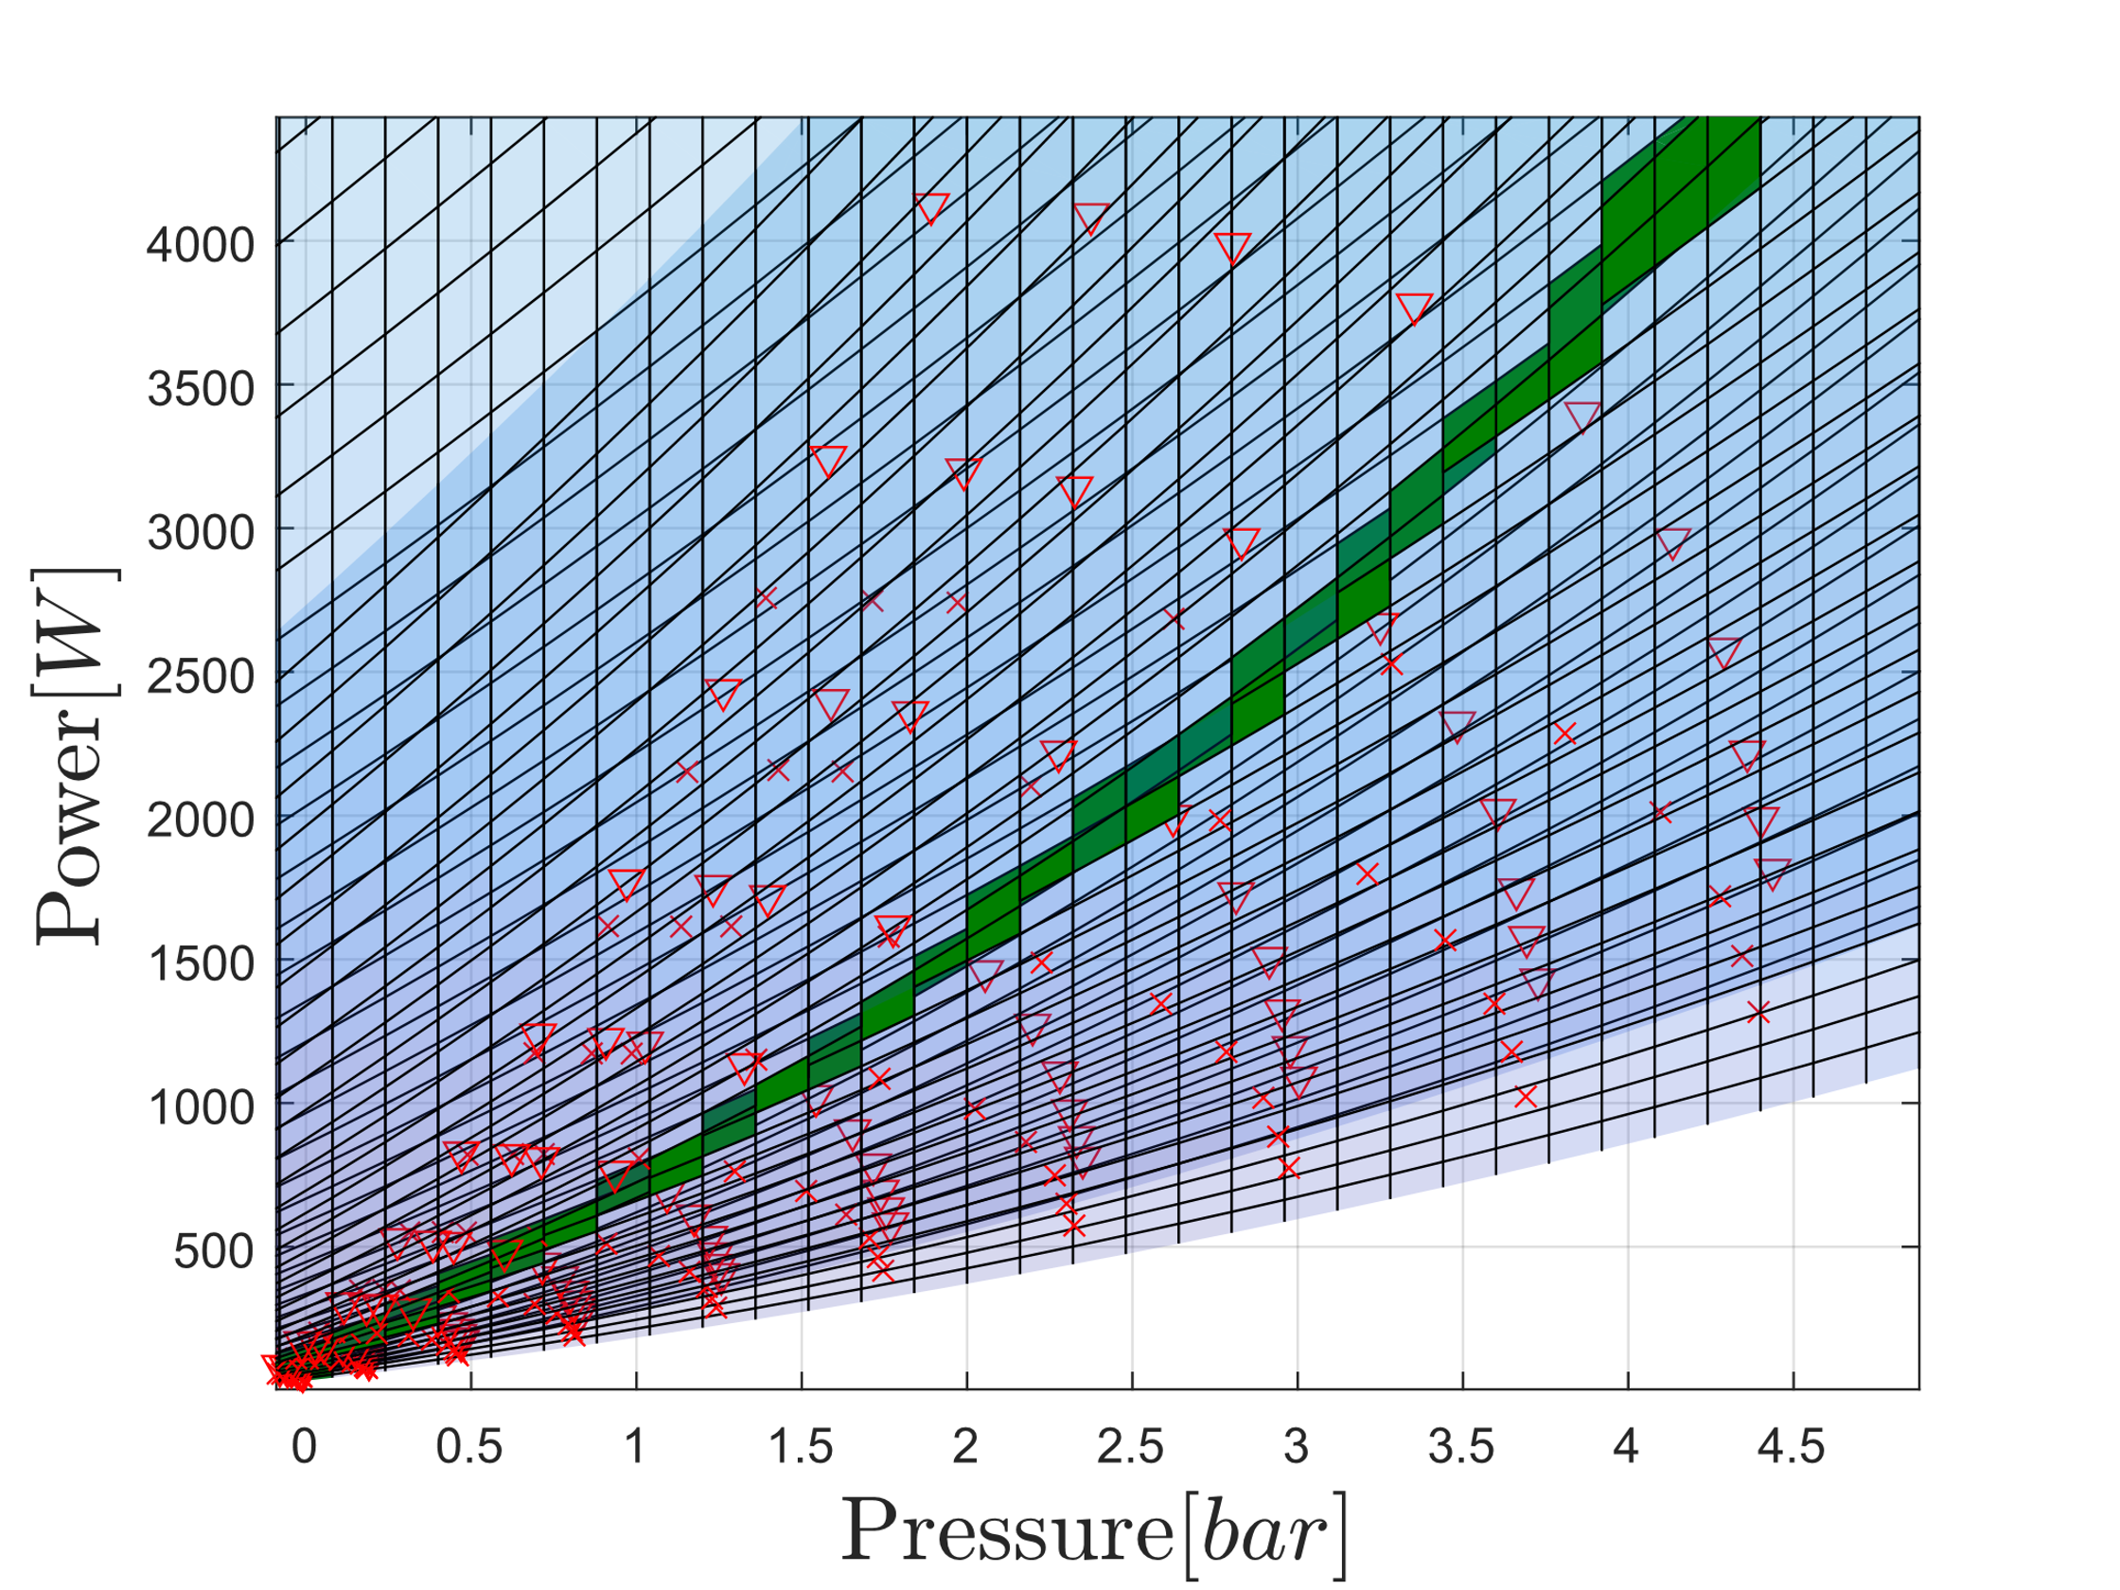

Slide 18
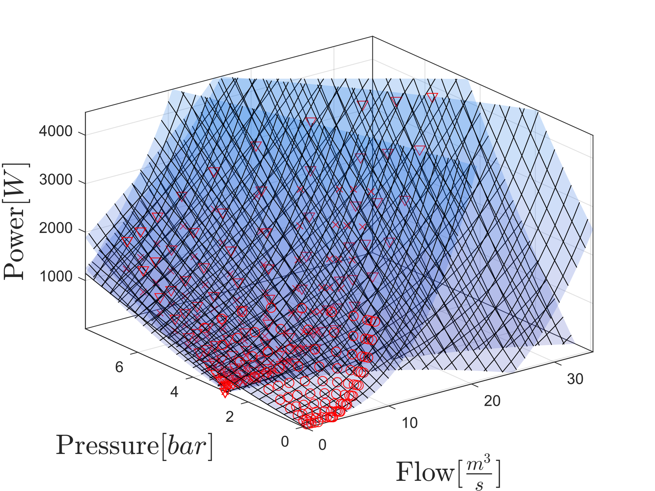
Power consumption
Combined Model

Slide 19
